Slide 1
Ajax-JSON
Waqar Yar

Slide 2
What isAJAX?
AJAX = Asynchronous JavaScript and XML
AJAX is a technique for creating fast and dynamic web pages.
AJAX allows web pages to be updated asynchronously by exchanging small amounts of data with the server behind the scenes. This means that it is possible to update parts of a web page, without reloading the whole page.
Classic web pages, (which do not use AJAX) must reload the entire page if the content should change.

Slide 3
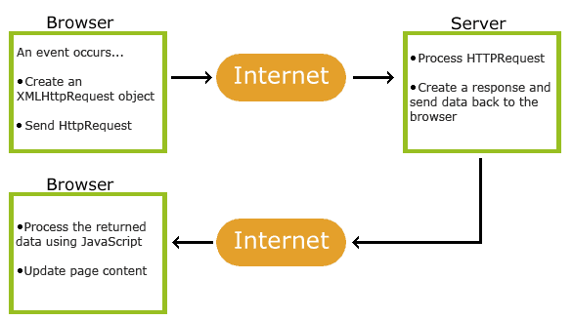
How does Ajax Work.

Slide 4
Ajax based on Internet Standards.
AJAX is based on internet standards, and uses a combination of:
XMLHttpRequest object (to retrieve data from a web server)
JavaScript/DOM (to display/use the data)

Slide 5
Ajax-What can it do?
Ajax can do the following:
Update a web page without reloading the page
Request data from a server - after the page has loaded
Receive data from a server - after the page has loaded
Send data to a server - in the background

Slide 6
Ajax Example
<!DOCTYPE html> <html> <body> <div id="demo"><h2>Let AJAX change this text</h2></div> <button type="button" onclick="loadDoc()">Change Content</button> </body> </html>

Slide 7
Ajax Example
function loadDoc() { var xhttp = new XMLHttpRequest(); xhttp.onreadystatechange = function() { if (xhttp.readyState == 4 && xhttp.status == 200) { document.getElementById("demo").innerHTML = xhttp.responseText; } }; xhttp.open("GET", "ajax_info.txt", true); xhttp.send(); }

Slide 8
XMLHttpRequest Object
All modern browsers support the XMLHttpRequest object.
The XMLHttpRequest object is used to exchange data with a server behind the scenes. This means that it is possible to update parts of a web page, without reloading the whole page.
All modern browsers (Chrome, IE7+, Firefox, Safari, and Opera) have a built-in XMLHttpRequest object.
Syntax for creating an XMLHttpRequest object:
variable = new XMLHttpRequest();

Slide 9
Sending an Ajax Request of Server.
The XMLHttpRequest object is used to exchange data with a server.
To send a request to a server, we use the open() and send() methods of the XMLHttpRequest object
xhttp.open("GET", "ajax_info.txt", true); xhttp.send();

Slide 10
GET\POST in Ajax
GET is simpler and faster than POST, and can be used in most cases.
However, always use POST requests when:
A cached file is not an option (update a file or database on the server).
Sending a large amount of data to the server (POST has no size limitations).
Sending user input (which can contain unknown characters), POST is more robust and secure than GET.

Slide 11
GET Example
xhttp.open("GET", "demo_get.asp?t=" + Math.random(), true);
xhttp.send();

Slide 12
POST Example
xhttp.open("POST", "ajax_test.asp", true);
xhttp.setRequestHeader("Content-type", "application/x-www-form-urlencoded");
xhttp.send("fname=Henry&lname=Ford");

Slide 13
Server Response
To get the response from a server, use the responseText or responseXML property of the XMLHttpRequest object.
responseText gets the response data as a string
document.getElementById("demo").innerHTML = xhttp.responseText;
responseXMLget the response data as XML data

Slide 14
Example to get XML Response.
xmlDoc = xhttp.responseXML; txt = ""; x = xmlDoc.getElementsByTagName("ARTIST"); for (i = 0; i < x.length; i++) { txt += x[i].childNodes[0].nodeValue + "<br>"; } document.getElementById("demo").innerHTML = txt;

Slide 15
Ajax Events
When a request to a server is sent, we want to perform some actions based on the response.
The onreadystatechange event is triggered every time the readyState changes.
The readyState property holds the status of the XMLHttpRequest.

Slide 16
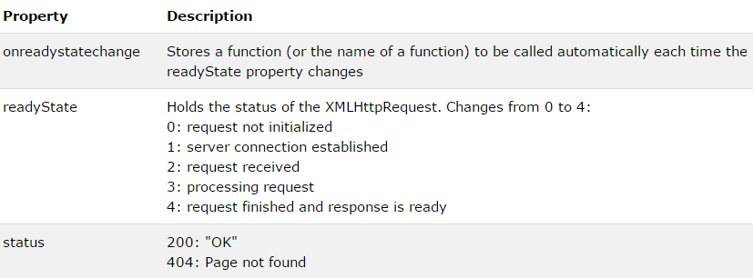
Ajax Events

Slide 17
Ajax Events Example
function loadDoc() { var xhttp = new XMLHttpRequest(); xhttp.onreadystatechange = function() { if (xhttp.readyState == 4 && xhttp.status == 200) { document.getElementById("demo").innerHTML = xhttp.responseText; } };

Slide 18
JSON
JSON: JavaScript Object Notation.
JSON is a syntax for storing and exchanging data.
JSON is an easier-to-use alternative to XML.
JSON is a lightweight data-interchange format
JSON is language independent *
JSON is "self-describing" and easy to understand

Slide 19
JSON Example
{"employees":[ {"firstName":"John", "lastName":"Doe"}, {"firstName":"Anna", "lastName":"Smith"}, {"firstName":"Peter", "lastName":"Jones"} ]}

Slide 20
Benefits of JSON
The JSON format is syntactically identical to the code for creating JavaScript objects.
Because of this similarity, instead of using a parser (like XML does), a JavaScript program can use standard JavaScript functions to convert JSON data into native JavaScript objects.

Slide 21
Example
<!DOCTYPE html> <html> <body> <h2>JSON Object Creation in JavaScript</h2> <p id="demo"></p> <script> var text = '{"name":"John Johnson","street":"Oslo West 16","phone":"555 1234567"}'; var obj = JSON.parse(text); document.getElementById("demo").innerHTML = obj.name + "<br>" + obj.street + "<br>" + obj.phone; </script> </body> </html>

Slide 22
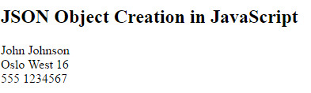
Result of JSON Exmaple.

Slide 23
JSON -Syntax
JSON syntax is derived from JavaScript object notation syntax:
Data is in name/value pairs
Data is separated by commas
Curly braces hold objects
Square brackets hold arrays

Slide 24
JSON -Syntax
JSON Data:
JSON data is written as name/value pairs.
A name/value pair consists of a field name (in double quotes), followed by a colon, followed by a value
Example: "firstName":"John“
JSON values can be:
A number (integer or floating point)
A string (in double quotes)
A Boolean (true or false)
An array (in square brackets)
An object (in curly braces)
null

Slide 25
JSON -Syntax
JSON objects are written inside curly braces.
Just like JavaScript, JSON objects can contain multiple name/values pairs:
Example: {"firstName":"John", "lastName":"Doe"}
JSON arrays are written inside square brackets.
Just like JavaScript, a JSON array can contain multiple objects:
"employees":[ {"firstName":"John", "lastName":"Doe"}, {"firstName":"Anna", "lastName":"Smith"}, {"firstName":"Peter","lastName":"Jones"} ]

Slide 26
How to use JSON
A common use of JSON is to read data from a web server, and display the data in a web page.
Create and Object:
var text = '{ "employees" : [' + '{ "firstName":"John" , "lastName":"Doe" },' + '{ "firstName":"Anna" , "lastName":"Smith" },' + '{ "firstName":"Peter" , "lastName":"Jones" } ]}';
var obj = JSON.parse(text);

Slide 27
How to use JSON
Use the new JavaScript object in your page:
<p id="demo"></p> <script> document.getElementById("demo").innerHTML = obj.employees[1].firstName + " " + obj.employees[1].lastName; </script>

Slide 28
JSON Example
<div id="id01"></div> <script> var xmlhttp = new XMLHttpRequest(); var url = "myTutorials.txt"; xmlhttp.onreadystatechange = function() { if (xmlhttp.readyState == 4 && xmlhttp.status == 200) { var myArr = JSON.parse(xmlhttp.responseText); myFunction(myArr); } }; xmlhttp.open("GET", url, true); xmlhttp.send(); function myFunction(arr) { var out = ""; var i; for(i = 0; i < arr.length; i++) { out += '<a href="' + arr[i].url + '">' + arr[i].display + '</a><br>'; } document.getElementById("id01").innerHTML = out; } </script>

Slide 29
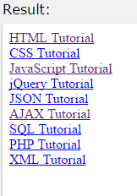
Result of JSON

